Slide 1
Trie data structure

Slide 2
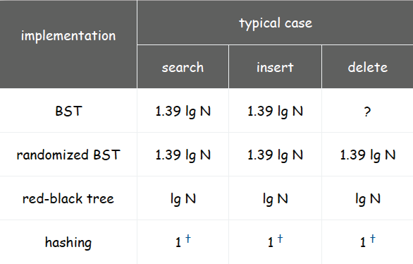
Review: summary of the performance of symbol-table implementations
Frequency of operations.
Q. Can we do better?
A. Yes, if we can avoid examining the entire key, as with radix sorting.

Slide 3
Digital keys (review)
Digital key. Sequence of digits over fixed alphabet.
Radix. Number of digits in alphabet.
Applications.
DNA: sequence of a, c, g, t.
IPv6 address: sequence of 128 bits.
English words: sequence of lowercase letters.
Protein: sequence of amino acids A, C, ..., Y.
Credit card number: sequence of 16 decimal digits.
International words: sequence of Unicode characters.
Library call numbers: sequence of letters, numbers, periods.

Slide 4
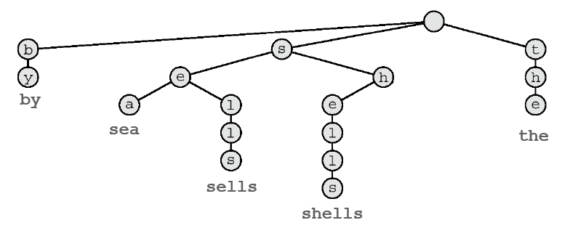
Tries
Tries
Store characters in internal nodes, not keys.
Store records in external nodes.
Use the characters of the key to guide the search.
Ex. sells sea shells by the sea

Slide 5
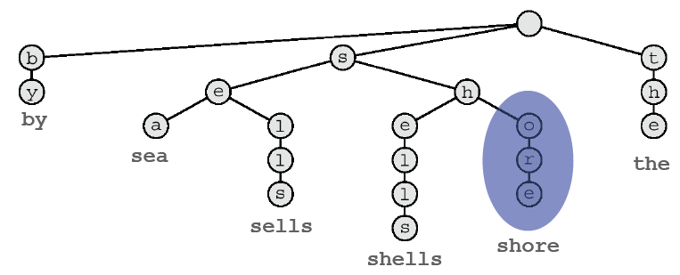
Tries
Tries
Store characters in internal nodes, not keys.
Store records in external nodes.
Use the characters of the key to guide the search.
Ex. sells sea shells by the sea shore

Slide 6
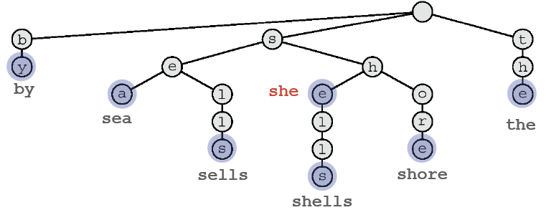
Tries
Q. How to handle case when one key is a prefix of another?
A1. Append sentinel character '\0' to every key so it never happens.
A2. Store extra bit to denote which nodes correspond to keys.
Ex. she sells sea shells by the sea shore

Slide 7
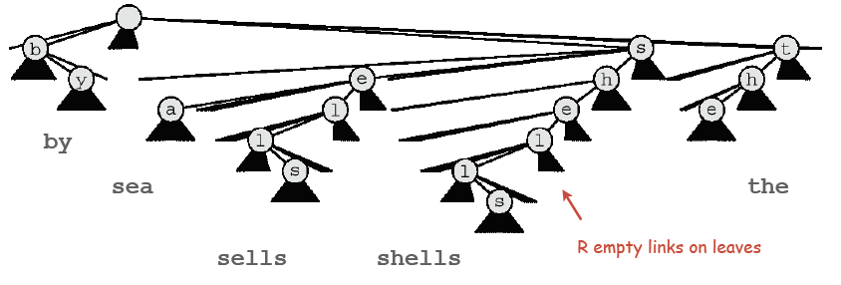
Branching in tries
Q. How to branch to next level?
A. One link for each possible character.
Ex. sells sea shells by the sea

Slide 8
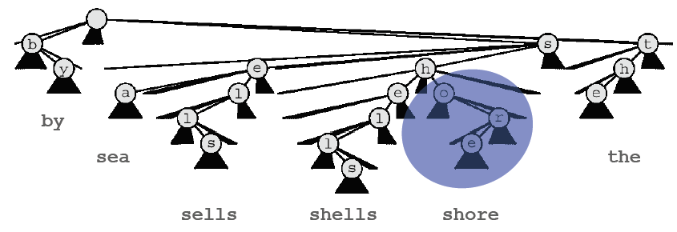
Branching in tries
Q. How to branch to next level?
A. One link for each possible character.
Ex. sells sea shells by the sea shore

Slide 9
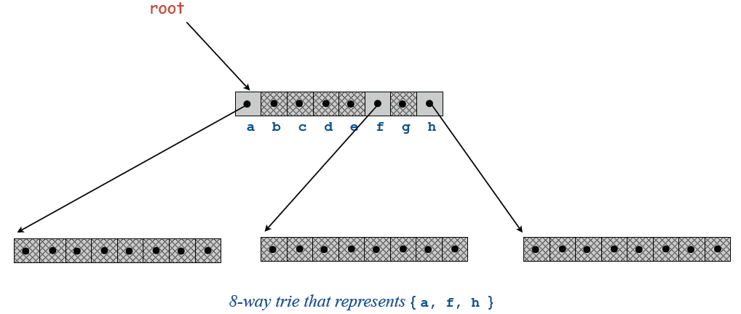
R-way existence trie: Java implementation
Node. References to R nodes.
class Node
{
Node[] next = new Node[R];
boolean end;
}

Slide 10
R-way existence trie: Java implementation
public void add(String s)
{ root = add(root, s, 0); }
private Node add(Node x, String s, int d)
{
if (x == null) x = new Node();
if (d == s.length()) x.end = true;
else
{
char c = s.charAt(d);
x.next[c] = add(x.next[c], s, d+1);
}
return x;
}
public class StringSET
{
private static final int R = 128;
private Node root = new Node();
private class Node
{
private Node[] next = new Node[R];
private boolean end;
}
public boolean contains(String s)
{ return contains(root, s, 0); }
private boolean contains(Node x, String s, int d)
{
if (x == null) return false;
if (d == s.length()) return x.end;
char c = s.charAt(d);
return contains(x.next[c], s, d+1);
}

Slide 11
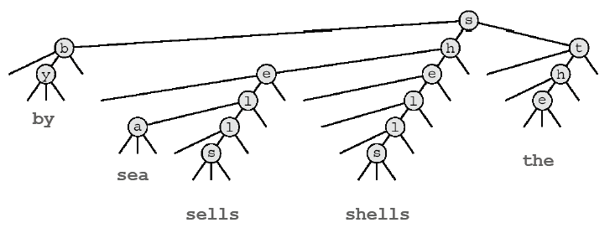
Ternary search tries
TST
Store characters in internal nodes, records in external nodes.
Use the characters of the key to guide the search
Each node has three children: smaller (left), equal (middle), larger (right).
Ex. sells sea shells by the sea

Slide 12
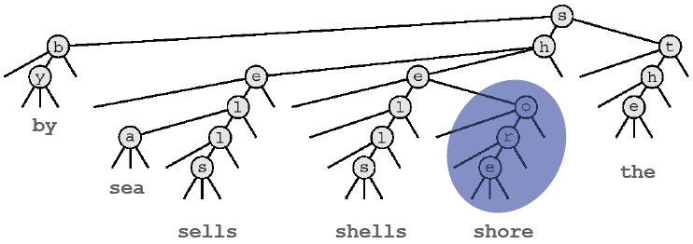
Ternary search tries
TST
Store characters in internal nodes, records in external nodes.
Use the characters of the key to guide the search
Each node has three children: smaller (left), equal (middle), larger (right).
Ex. sells sea shells by the sea shore

Slide 13
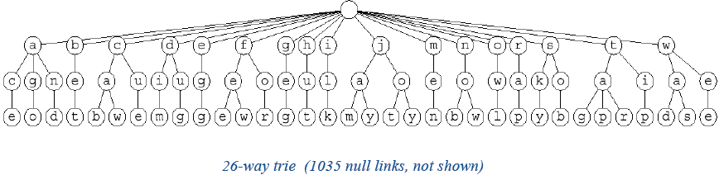
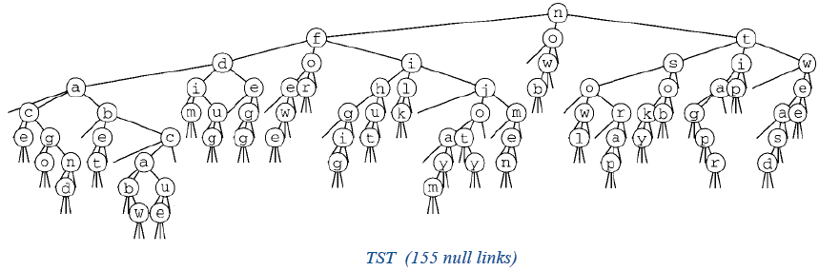
26-Way Trie vs. TST
TST. Collapses empty links in 26-way trie.

Slide 14
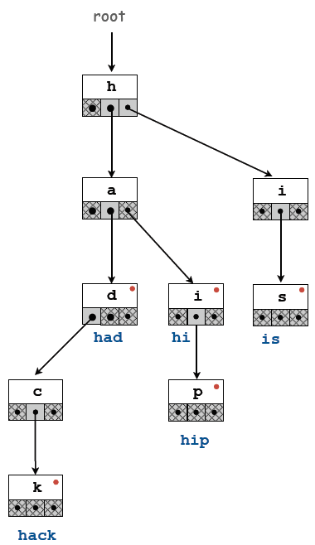
TST representation
A TST node is five fields:
A character c.
A reference to a left TST. [smaller]
A reference to a middle TST. [equal]
A reference to a right TST. [larger]
A bit to indicate whether this node is the last character in some key.
class Node
{
char c;
Node left, mid, right;
boolean end;
}

Slide 15
TST: Java implementation
public class TST
{
private class Node
{ /* see previous slide */ }
public boolean contains(String s)
{ return contains(root, s, 0); }
private boolean contains(Node x, String s, int d)
{
if (x == null) return false;
char c = s.charAt(d);
if (c < x.c) return contains(x.left, s, d);
else if (c > x.c) return contains(x.right, s, d);
else if (d < s.length()-1) return contains(x.mid, s, d+1);
else return x.end;
}
public void add(String s)
{ root = add(root, s, 0); }
private Node add(Node x, String s, int d)
{
char c = s.charAt(d);
if (x == null) x = new Node(c);
if (c < x.c) x.left = add(x.left, s, d);
else if (c > x.c) x.right = add(x.right, s, d);
else if (d < s.length()-1) x.mid = add(x.mid, s, d+1);
else x.end = true;
return x;
}
}

Slide 16
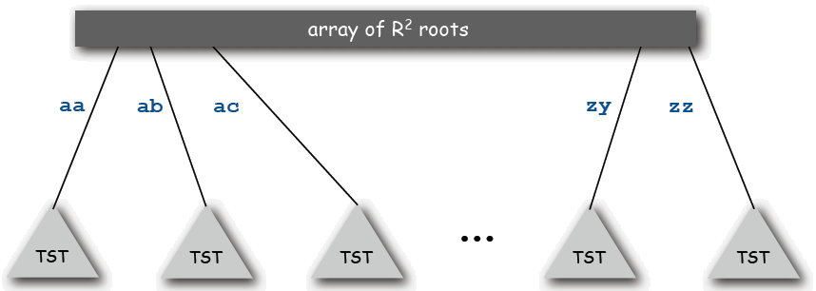
TST with R2 branching at root
Hybrid of R-way and TST.
Do R^2-way branching at root.
Each of R^2 root nodes points to a TST.

Slide 17
TST vs. hashing
Hashing.
Need to examine entire key.
Hits and misses cost about the same.
Need good hash function for every key type.
No help for ordered-key APIs.
TSTs.
Works only for digital keys.
Need to examine just enough key characters.
Search miss may only involve a few characters.
Can handle ordered-key APIs.
Bottom line. TSTs are faster than hashing (especially for search misses) and more flexible than red-black trees.

